Slide 1
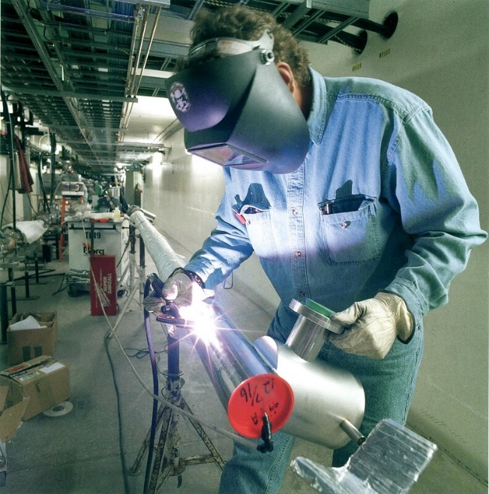
Ergonomics in Welding
Guidelines to Prevent Sprain, Strain and Overuse (SSO) Injuries
Notes:
Note to employers:
We recommend customizing this presentation by adding photos and examples from your own workplace. This will help workers better understand how to apply what they learn to their own jobs.
Be sure to include the hazards discussed here in your Accident Prevention Program (APP).
Information about APP:
https://lni.wa.gov/safety-health/preventing-injuries-illnesses/create-a-safety-program/accident-prevention-program
Photo: US Government Works. Public Domain. CC

Slide 2
Purpose of this training
Help you identify causes of sprain, strain and overuse (SSO) injuries in welding tasks
Propose solutions to reduce potential SSO injuries
Provide resources to make your welding worksites safer

Slide 3
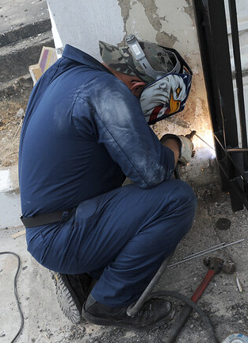
Sprain, strain and overuse (SSO) injuries
Physical damage that occurs over time, and not so much from a single incident
Happen when the physical demands of work cause wear and tear on the body
Involve soft tissues such as muscles, tendons, ligaments, joints, nerves, blood vessels.
Neck strain
Carpal tunnel syndrome;
Tendinitis
Rotator cuff tears; Bursitis
Tennis elbow
Bursitis; Meniscus tears
Notes:
You might think of workplace injuries as those that are immediate and have a visible, obvious effect, such as a broken bone or cut. It’s easy to see what happened—someone tripped or was hit by an object. It’s easy to figure out the hazards, and maybe even the solutions, to keep it from happening again.
Common hazards in welding are -
Inhaling metal fumes
Eye exposure to welding arc light
Foreign objects in the eyes
Burns
Noise
But Sprain, Strain and Overuse (SSO) injuries can develop over a long period of time. The effects are less visible, such as tingling, numbness or pain. And, they often take a long time to heal.
Photo: US Government. Public Domain. CC

Slide 4
Common SSO injuries among welders
Back injuries
Shoulder pain with loss of movement
Tendinitis or bursitis
Muscle weakness
Carpal tunnel syndrome
White finger (Raynaud’s Syndrome)
Knee injuries
Notes:
More than half of all serious injuries happen to welders’ upper bodies--backs, necks, shoulders, hands and arms. A bad back or shoulder injury can pull you off work for a long time. You may lose income.
Compensable claims data from 1994-2004, Washington State

Slide 5
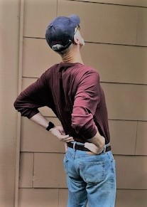
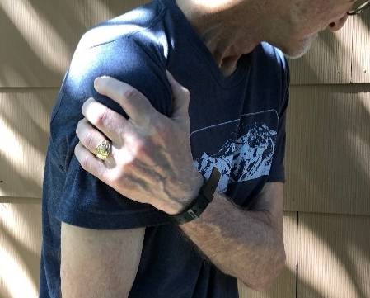
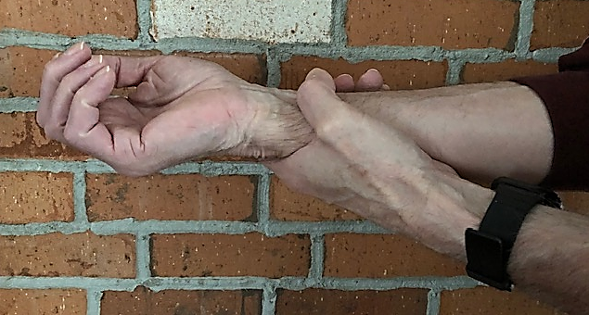
Sprain, strain and overuse injuries hurt
Signs and symptoms
Pain
Tingling
Numbness
Swelling
Loss of strength
Loss of motion
Change in color

Slide 6
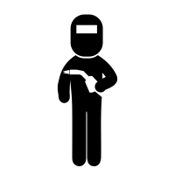
Sprain, strain and overuse injuries can keep you from working
About 1/3 of compensable claims among welders are due to sprains and strains.
Compensable injury claims involve time loss or disability payments.
Notes:
Pain, loss of strength or other symptoms can make it difficult to work, or to do a good job. The things you enjoy doing outside of work are affected, too.
Compensable claims data from 1994-2004, Washington State

Slide 7
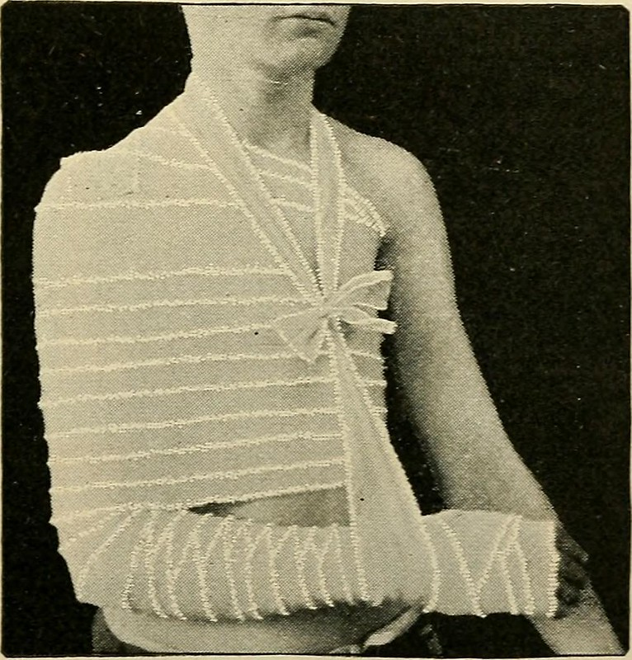
Costly consequences affect employers, too
Loss of skilled welders -
Absences due to injury and the transfer of welders to light duty tasks
Overtime for replacement workers
High employee turnover
Increased training and supervisory time
Reduced productivity and quality
Notes:
Employers may end up paying more for workers’ comp insurance. These other consequences get costly, too.
Photo: Public Domain. CC

Slide 8
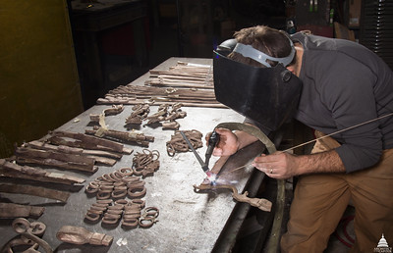
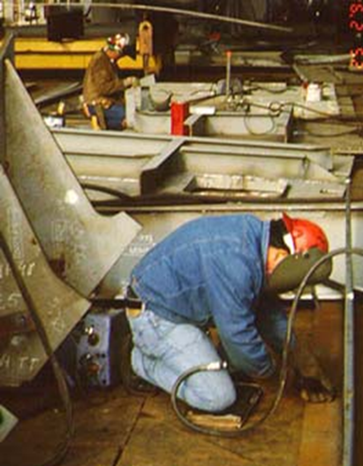
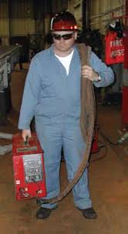
Common causes of SSO injuries in welding
Precise hand movements for detailed, uniform work
Awkward work positions, held for a long time
Lifting heavy equipment or materials
Repetition, with high work intensity
Combinations of these
Notes:
Awkward postures, force and high repetition are typical sources of sprain, strain and overuse injuries in most industries. Welding is no exception.
Often, 2 or more of these causes occur at the same time. This makes the job riskier. Workers are more likely to get hurt when more than one cause happens at the same time and to the same body part.
Photos (clockwise):
US Capitol. Public Domain. CC
OSHA
NIOSH

Slide 9
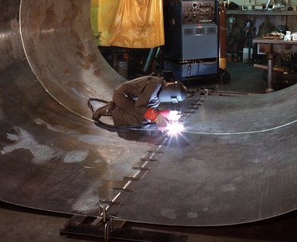
These things matter
Duration
  How long do you stay in that position?
  How much time, in total, do you lift in the course of the day?
Frequency
  How often do you repeat the same weld every hour or each minute?
  How many times do you lift that heavy tool in an hour?
Intensity
  How much does it weigh?
  How far do you bend or twist your back?
  How hard do you grip that tool?
Notes:
Exerting force, getting into awkward postures, and doing things repetitively won’t automatically cause injury.
The impact to your body depends on these additional things—how long, how often and how much you do it.
For instance, you may get into a twisted, bent position when in a confined space. If it’s for several minutes but only once a week, it’s less likely to have any lasting impact on your body. In contrast, if you must kneel on metal with your head close to the floor for several hours every day for weeks, that’s a different story. The affects on your body will be much greater and could be long lasting.
Photo: US Department of Energy. Public Domain. CC

Slide 10
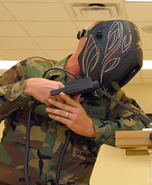
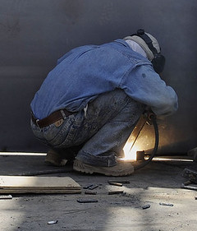
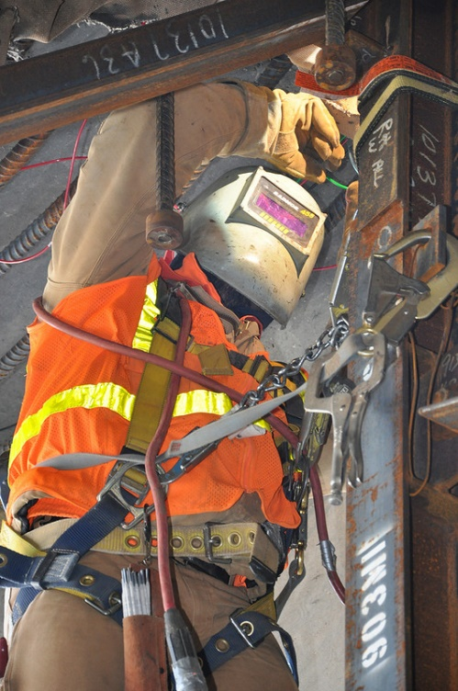
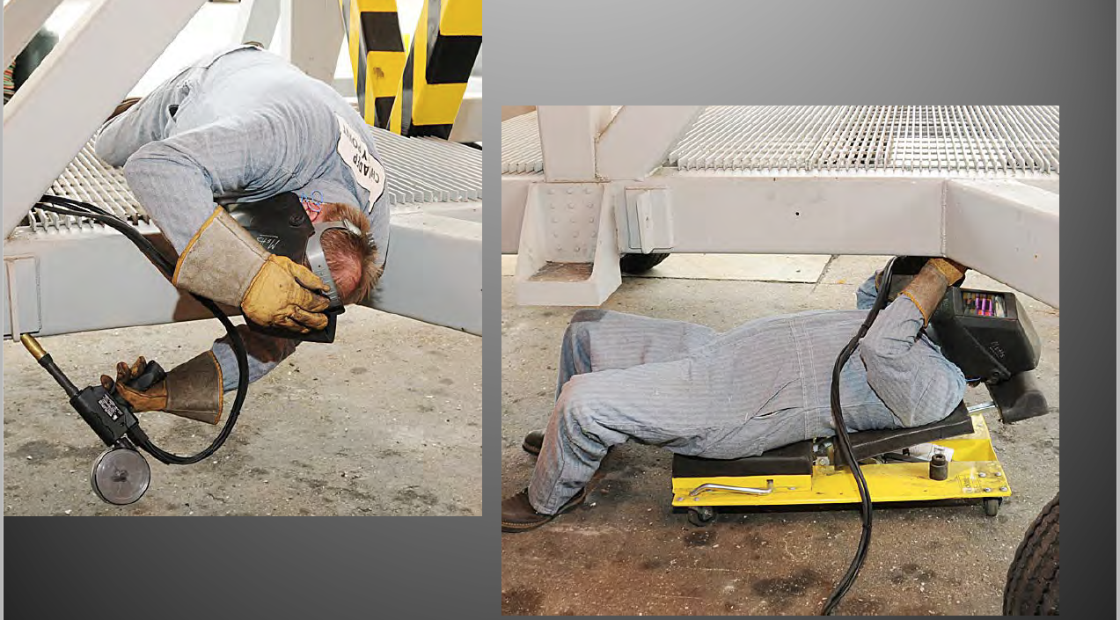
Awkward postures in welding
Extreme back bending
Back twisting
Kneeling and squatting
Neck bending up or down
Shoulders reaching out or up
Wrist bending
Notes:
Awkward body positions can cause fatigue, reduce concentration and lead to poor welds which may need to be repeated.
Postures that you have to hold for a long time—”static” postures—are especially fatiguing. It takes muscles longer to recover from static postures than it does to recover from high repetition.
Photos (clockwise):
US Department of Defense. Public domain. CC
US Air Force. Public Domain. CC
US Government Works. Public Domain. CC
Navy Ergonomics Program Course

Slide 11
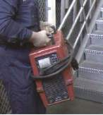
Forces in welding
Lifting and carrying heavy loads, such as cables, cylinders or welding units
Continuous forceful grip on tools
  Gripping with 10 lbs. or more of force, or
  Gripping an unsupported object weighing 10 lbs. or more per hand, and
  Gripping for more than 4 hours
Notes:
The forceful gripping definition comes from the L&I Hazard Zone Checklist.
Photo: OSHA Shipyard Ergonomics 2003

Slide 12
Ergonomics Solutions for Welding

Slide 13
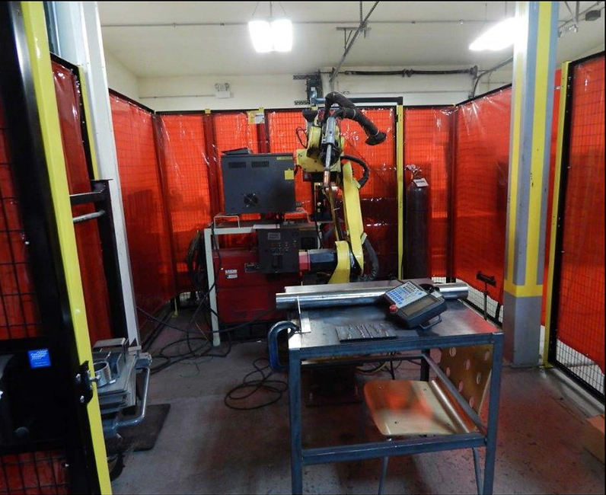
Healthy work environment
Goal: To simplify the welding tasks and reduce the physical effort
Automate physically demanding or repetitive jobs
Expand the work content and skills of the welders
  to provide a variety of movements and postures between tasks
Robotic Welder
Notes:
Welders with multiple skills can perform a variety of tasks.
Learning new skills allows you to move from task to task, so you can change your posture, the way you move, and perhaps, the amount of forceful effort.
Photo: US Government. Public Domain

Slide 14
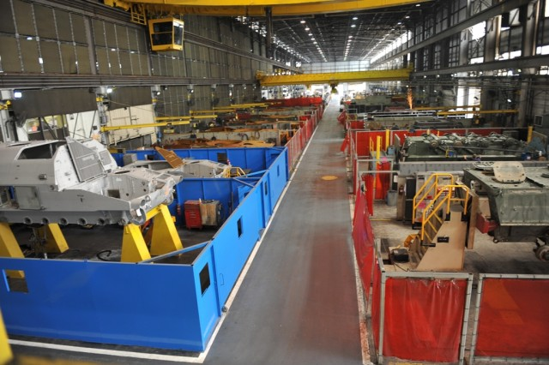
The real world
Often cost, ease of maintenance, and space considerations drive the design of the workplace
When hazards can’t be designed out, use best practices as a good alternative
  Examples of best practices:
    adjustable work stations
    providing different types of tools
    use planning to eliminate unnecessary work
Notes:
Photo: Anniston Army Depot, Alabama, 2010 -The depot remodeled its welding bays, bringing in safer, lighter weight and more efficient welding equipment.
Previous MIG welding equipment was replaced with pulse welding. Pulse welding offers a decrease in defects with less heat input, less smoke emission and reduced cadmium exposure. Pulse welding equipment weighs much less than MIG welding equipment (80 pounds versus 400 pounds).
The depot converted its curtain-wrapped welding bays to ones surrounded by steel walls and windows. Other improvements included welder-specific toolboxes and better lighting in the shop.
Photo credit: US Army. https://www.army.mil/article/40723/welding_modernization_underway_at_anad

Slide 15
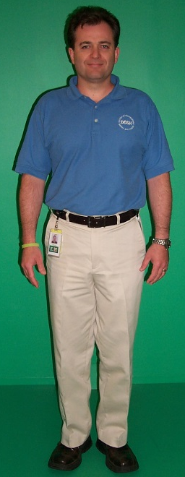
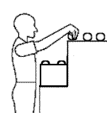
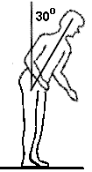
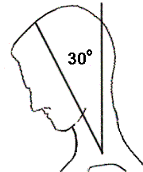
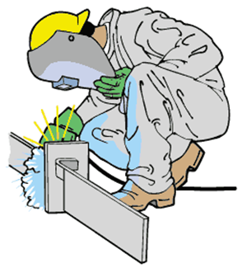
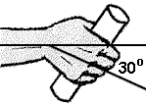
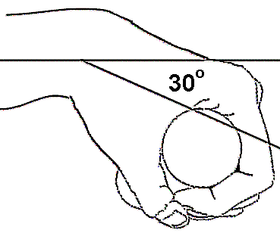
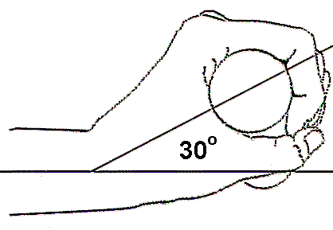
Neutral posture vs. awkward postures
Neutral
Awkward
Muscles balanced
Spine aligned
Arms near body
Head level
Wrists straight
Elbows away from body
Back or neck bent
Squatting or kneeling
Wrists bent
Notes:
For more information about awkward postures and appropriate durations, see the LNI Caution and Hazard Zone Job Checklists:
https://lni.wa.gov/safety-health/preventing-injuries-illnesses/sprains-strains/evaluation-tools
Photo: L&I. Public Domain.

Slide 16

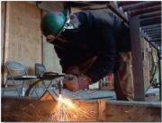
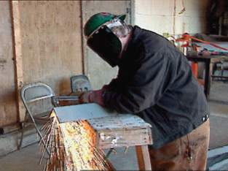
Reduce awkward postures
Position work between waist and shoulder when possible
  Raise the work
Notes:
Photos:
US government works. Public Domain. CC
OSHA Shipyard Ergonomics 2003

Slide 17
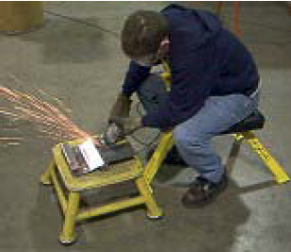
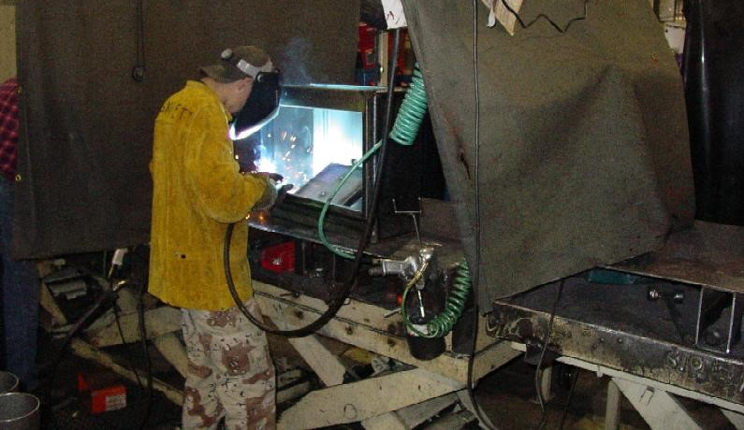
Reduce awkward postures
Use:
Lifting tables and turntables
Motorized positioning devices
Adjustable stools and creepers
Welding guns with swivels, and designed for use in both hands
Notes:
Photos (clockwise)
US Navy Ergonomics Program Course
US Navy Ergonomics for Welders
L&I Demonstration Project. Public Domain

Slide 18
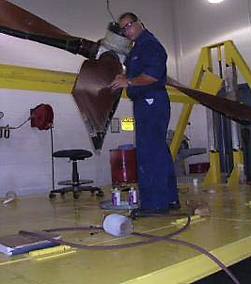
Reduce heavy lifting
Use:
Manipulators and Positioners
Lighter weight welding equipment
Lighter weight cables with low stiffness
Cable supporting balancers
Store hoses and cables off the floor
Notes:
Photo: US Navy Ergonomics Guide for Welders, 2012

Slide 19
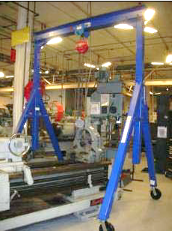
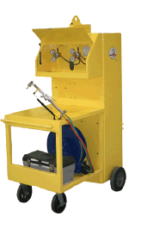
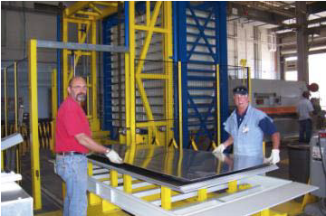
Reduce unnecessary material handling
Use:
Pre-assembled materials
Material handling equipment
  Overhead or portable hoists
  Jigs
  Carts
  Storage and handling systems
Notes:
Jigs and carts can be customized. The USAF designed the yellow cart to transport cylinders. It also stores leads and hoses.
Photos: US Navy Ergonomics Guide for Welders, 2012

Slide 20
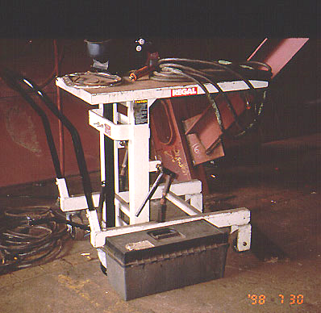
Reduce lifting, carrying and awkward postures
Use wheeled tables
for welding work
to transport stock and jobs
that adjust in height for optimal work positions
Notes:
Photo: NIOSH Ergonomics interventions

Slide 21
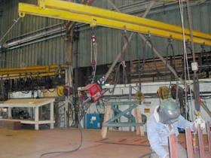
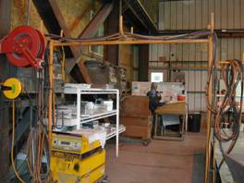
Reduce heavy and awkward lifting
Overhead reels and handling systems keep hoses untangled and reduce the need to drag, bend over, and lift them.
Notes:
Photos: OSHA shipyard ergonomics, 2003

Slide 22
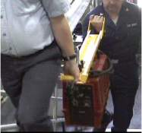
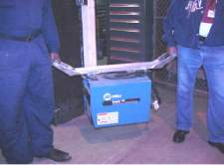
Reduce heavy lifting
Team lifting helps reduce heavy, awkward lifting of equipment and materials.
Notes:
Team lifting divides the weight, but is not without risk. A 300 lb. load is still a heavy lift at 150 lbs. per person. It’s better to find mechanical ways to lift and move heavy or awkward loads.
Photos: Dept. of Navy SIMA San Diego Ergonomics Program

Slide 23
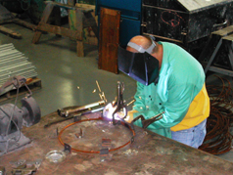
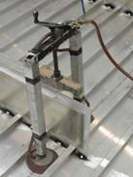
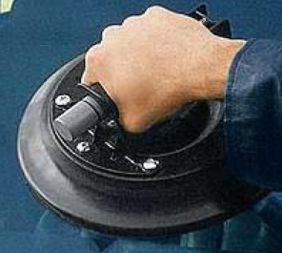
Reduce grip force and awkward wrist postures
Use mechanical devices as clamps, instead of your hand
Jigs allow 2-handed control of the tool
Portable electromagnetic and air presses hold parts in place
Magnets and vacuum handling devices provide better handles
Rotational clamps hold pipe in place
Jig in use
Notes:
Using your hand as a vice to hold parts in place while welding requires forceful gripping. Using a clamp instead reduces the force and the amount of time you have to hold onto a part.
Photos (clockwise):
OSHA.gov
US Navy Ergonomics Guide for Welders, 2012
OSHA Shipyard ergonomics, 2003

Slide 24
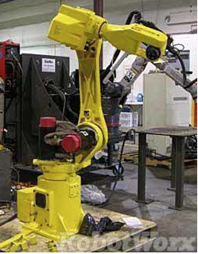
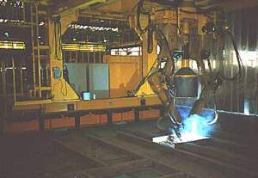
Reduce high repetition and awkward, static postures
Use robotic welders
This may also reduce exposure to fumes.
Notes:
Also known as Remote Operation Welding or Automated Welding.
Advantages:
Reduced fatigue from awkward or static postures
More efficient
Greater consistency of quality welds
Increased repeatability
Reduced production costs
Photos:
Top - US Navy Ergonomics Guide for Welders, 2012
NIOSH ergonomic interventions

Slide 25
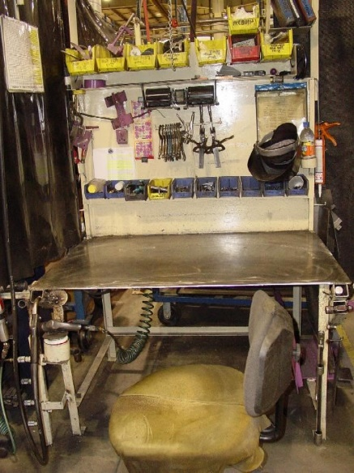
Reduce reaching and distraction
Well-organized work area
Important tools within easy reach
Increases productivity
Improves focus
Reduces errors
Saves time
Is safer
Notes:
Applying 5-S principles to your work area keeps things in order. Tools and parts are easy to find and to reach.
5-S stands for:
Sort – Get rid of things you don’t use or need; keep needed tools, parts and instructions.
Set in order – Organize, arrange and identify parts and tools for ease of use.
Shine – Clean it up.
Standardize – Schedule regular cleaning and maintenance.
Sustain – Continue with the above 4 steps; make it a way of life.
Photo: L&I Demonstration Project. Public Domain.

Slide 26
Resources
NIOSH’s Ergonomic Interventions in the Building, Repair, and Dismantling of Ships
Easy Ergonomics: A practical approach for improving the workplace Oregon OSHA
Learn more about preventing sprains and strains
Helpful tools for your Accident Prevention Program (APP)
SHARP Program
Notes:
Credits: The technical contents of this slideshow are based upon a presentation developed by Ninica Howard, MS, CPE, research ergonomist with the SHARP program at the Washington state Dept. of Labor and Industries.

Slide 27
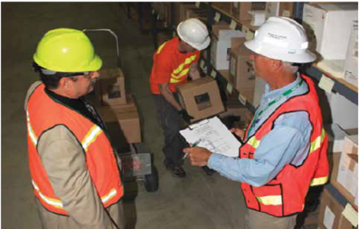
Help from L&I at no cost to you
We offer free, confidential consultations to help you prevent sprains and strains in your workplace.
To learn more:
Click here to email us at Ergonomics@Lni.wa.gov
Call – (360) 902-5450
Get help with ergonomics
Notes:
Photo: L&I. Public Domain

