Slide 1
Roofing Fall Protection
Training for roofing workers
Updated: December, 2020

Slide 2
Roofing Fall Protection Training
Why is fall protection required?
When is it required?
What is required?
Using & maintaining fall protection equipment
Photo by Patrick McConashay in Creative Commons
Notes:
This online training will cover the basics of fall protection in roofing. It will be followed up by hands-on training on the specific hazards and fall protection methods and equipment used at the jobsites where you will be working , and our policies and procedures related to fall protection.

Slide 3
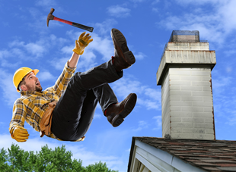
What happens if you fall off a roof?
Serious injury
or
death
YouTube video – Roofer dies after falling off roof
Notes:
It‘s pretty obvious. A fall from a roof will usually result in an injury serious enough to make it impossible to go back to work for some time, or result in a permanent disability or even death. One quarter or 25% of falls from elevations of just 10 feet result in death. The short YouTube video shows it.

Slide 4
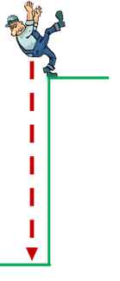
Think you can catch yourself? No way!
A fall from 10 feet takes less than a second to hit the ground.
10 feet
Notes:
Maybe you believe that your reaction time is so good and you are so quick – that you could catch yourself before you fall off the roof. This might work if you knew you were about to fall and there was actually something nearby to grab onto. But once you start to fall, you are out of arms reach in a blink of an eye.

Slide 5
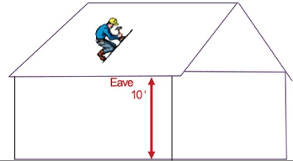
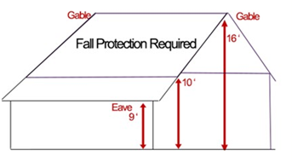
When is fall protection required?
Always, when working at 10 feet or above.
Notes:
There is one exception to the 10 foot rule. See next slide.

Slide 6
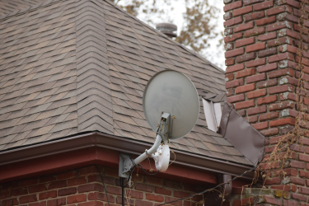
On a steep-pitched roof greater than 4 in 12, fall protection is required at a four foot elevation.
Notes:
In other words, whenever you are working four feet above the ground or another surface, on a steep-pitched roof, you must wear fall protection. The reason for the 4 foot rule is that it is easier to slip and fall on a steep pitched roof and serious injuries can still occur from an uncontrolled fall of just four feet.

Slide 7
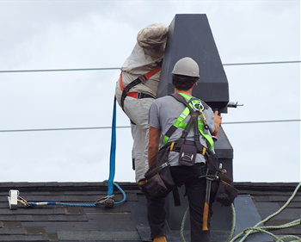
What types of fall protection exist?
Four choices:
a positioning device,
a personal fall restraint,
a personal fall arrest,
a warning line system.
Notes:
In roofing, the usual fall protection is personal fall arrest, with a full body harness,as shown in the photo. In some cases a warning line system is allowed.

Slide 8
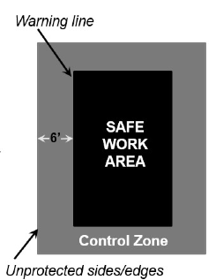
Warning Line System
Only allowed on low-pitched roofs - 4:12 slope or less.
Requires the presence of a safety monitor employee.
YouTube Video – Warning Line System
Notes:
The warning line system is mostly used on flat roofs or large low pitched roofs, and is not very practical for small residential roof jobs. Any work done outside the safe work area requires the use of personal fall protection. Watch the YouTube video for more details. [note the YouTube video from Oregon OSHA says warning line systems can only be used on low pitched roofs of 2:12 slope or less, which is an Oregon requirement only.]

Slide 9
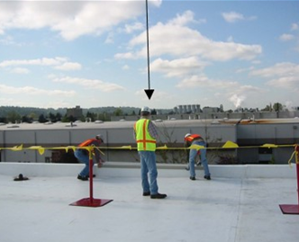
Safety monitor employee
A warning line system requires a safety monitor.
warn you if you are too close to the roof edge.
Notes:
Since a warning line will not prevent a fall, the safety monitor employee can’t have any other duties, and his job is to warn you or your co-workers if you in danger of falling. You must heed his instructions and warnings at all times. On small low pitched roof jobs that are less than 50 feet wide, a safety monitor only is acceptable.

Slide 10
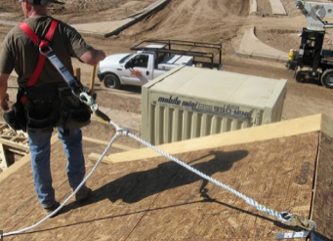
Two kinds of personal fall protection
Personal Fall Restraint – prevents a fall from happening
Personal fall Arrest – stops the worker after falling
Montana Building Industry Association
YouTube Video – Fall Protection Can Save Your Life
Notes:
Fall restraint is seldom used in roofing, since it limits movement and a roofer has to move about the roof, So the next slides will talk about fall arrest gear and how it will protect you from injury should you fall. The YouTube video explains that as well.

Slide 11
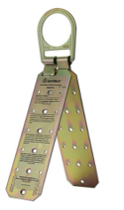
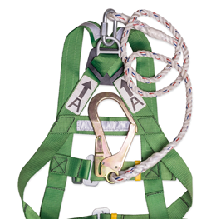
Personal Fall Arrest Equipment
Includes:
a full body harness,
a lanyard and lifeline,
a roof anchor.
roof anchor
Notes:
The photo shows a common type of anchor used in roofing, but there are other types as well. Anchors should be installed at the roof peak and no more than 8 feet apart. More about anchors following.

Slide 12
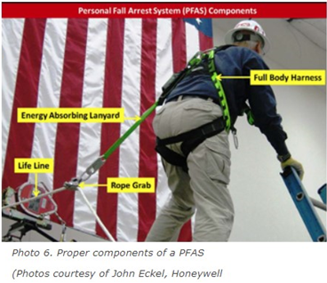
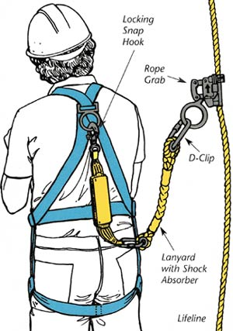
Notes:
These photos show the shock absorbing lanyard which is attached to a lifeline. The lanyard moves along the lifeline as you move about the roof, but will grab and hold on to the lifeline, should you fall.

Slide 13
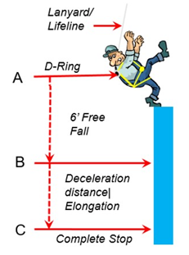
How fall arrest equipment works
If you fall, the fall protection equipment you wear will limit the free fall to 6 feet.
Because a sudden stop could injure you, the equipment includes a deceleration device to gradually stop the fall.
Notes:
The deceleration devices on fall arrest equipment consists of an energy-absorbing lanyard or shock absorber that slows the fall.

Slide 14
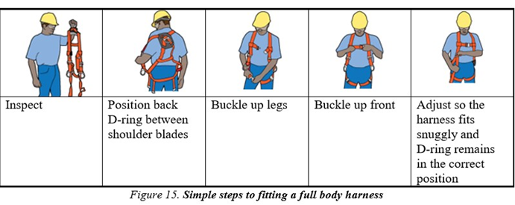
Fitting a full body harness
Oregon OSHA
Notes:
A full body harness distributes the force of a fall over your whole body and must be fitted properly to provide complete protection.

Slide 15
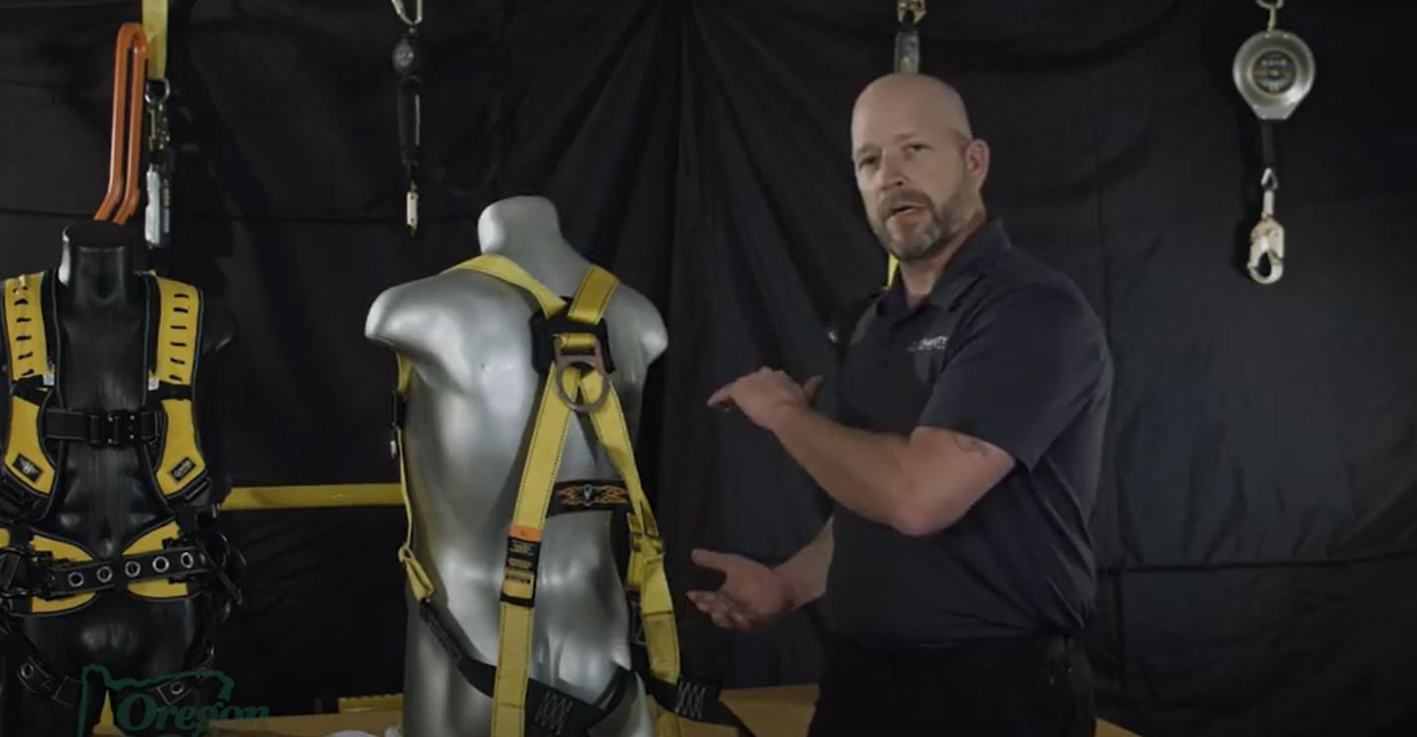
YouTube video - Using a Roof Safety Harness
(Always refer to the manufacturer's specific fitment requirements)

Slide 16
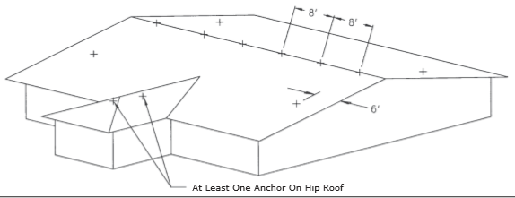
Image courtesy of DBI-Sala
YouTube Video – Installing Roof Anchors
Notes:
As stated earlier, roof anchors should be installed at the roof peak no more than 8 feet apart. The YouTube video shows more details.

Slide 17
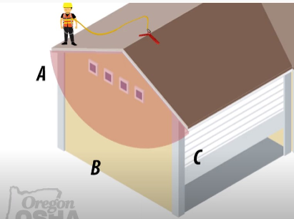
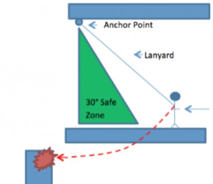
YouTube Video – Swing Fall Hazard
Notes:
The diagram illustrates the hazard of a swing fall which is often overlooked. The best way to prevent this is to try to stay directly underneath your anchor points as much as possible. If you stretch yourself at an angle of more than 30 degrees away from your anchorage point, it is time to either move your anchor, or hook on to a closer one. The YouTube video illustrates what can happen.

Slide 18
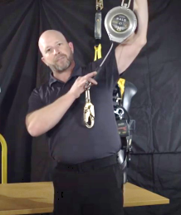
Self-retracting lifeline (SRL)
Some employer may use self-retracting lifeline fall protection instead of roof anchors.
The SRL will usually stop your fall faster than other types of fall protection equipment.
A disadvantage is that if you go too far sideways from the SRL, you can be injured in a swing fall.
Notes:
As stated in the previous slide, a swing fall can be avoided by not moving more than a 30 degree angle away from the self retracting lifeline anchor point.

Slide 19
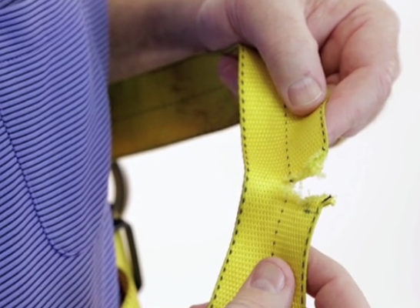
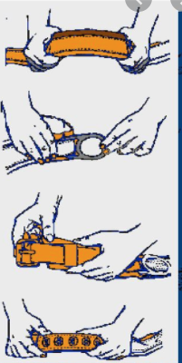
Inspecting fall protection equipment
Inspect all components of your personal fall protection system. Look for the following signs of wear and damage:
Abrasion or cuts,
Excessive wear,
frayed or kinked material,
loose or deformed connectors,
cracked or broken D-ring,
loose, distorted or broken belt grommets.
Photo by Fall Protection Systems
Notes:
In the harness webbing, look for frayed edges, broken fibers, pulled stitches, cuts, burns or other damage. Bending the webbing in an inverted U can make it easier to see damaged fibers or cuts.

Slide 20
YouTube Video – Performing a routine fall protection harness inspection
Notes:
[Note: this YouTube video is from the Seton company, but L & I does not endorse any particular brand of fall protection equipment.]

Slide 21
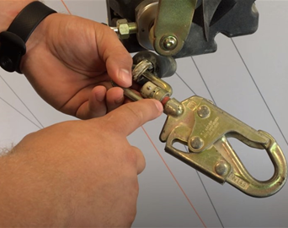
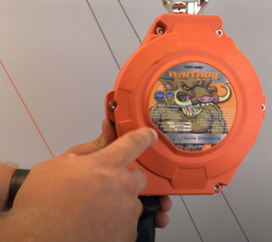
YouTube Video – How to Inspect a Self-Retracting Lifeline
Notes:
The short YouTube video shows how to inspect a self-retracting lifeline.

Slide 22
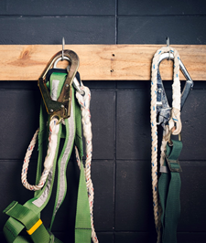
Maintaining fall protection equipment
If the equipment gets dirty, clean it with warm soapy water, rinse and hang up to dry.
Store your personal fall protection system in its own bag or other suitable container in a protected place where it cannot be damaged.
If a personal fall arrest system is subjected to a fall, don’t use it again until it can be determined that it’s safe.
Notes:
Fall protection equipment exposed to sunlight will deteriorate over time. With conscientious storage, regular care and a little maintenance, a well-made harness will perform at its highest level for many years.

Slide 23
Include worksite-specific training here
Notes:
[Note: The L & I Unified Fall Protection Rule requires training by a “competent person” who is knowledgeable about the fall hazards, the fall protection equipment, and how to use it properly.]

Slide 24
Additional Resources
L& I Unified Fall Protection Rule
Roofing fall protection online course
Fall protection work plan checklist
Notes:
[The roofing fall protection online course is identical to this presentation, but requires additional worksite-specific training by a competent person as outlined in the Unified Fall Protection Rule. Also, it cannot be modified, unlike this Powerpoint presentation.]

