Slide 1

How to Prevent Injuries in Hand Intensive Work
Ergonomics Design Guidelines to Prevent Sprain, Strain and Overuse (SSO) Injuries
Notes:
Photo credit: Adobe Stock. This photo is not in the public domain.

Slide 2
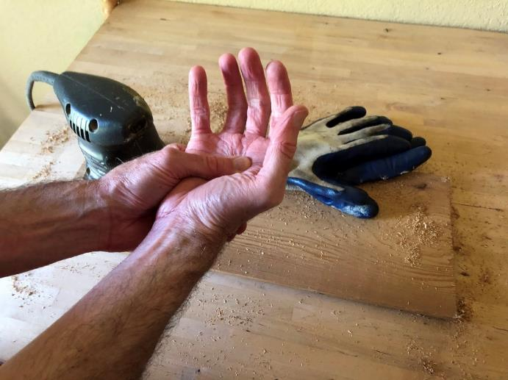
Hand and wrist injuries
The hands and wrists are made up of bones, tendons, ligaments, nerves, and blood vessels that can be damaged if they are overused.
Notes:
With the right amount of use, our hands get stronger and more coordinated. With overuse, soft tissues can get damaged. Without enough time to heal between overuse sessions, injuries can occur.

Slide 3
Causes of injury
Common causes of hand and wrist injuries include:
    Forceful gripping or pinching
    Bending the wrists
    Repetitive hand and arm movements
The risk of injury is higher if more than one of these causes is present at the same time.
Notes:
There are 3 big risks for sprains, strains and overuse injuries – force, posture, and repetition. The risk of injury is much higher if workers are exposed to more than one of these risks at the same time. For example, a job that involves repetitive motions with a lot of hand force is at much higher risk for injury than a job with repetition alone.

Slide 4
What increases risk of injury?
Intensity – how much?
  Do you use a lot of grip force, or a little?
  Do you bend your wrist as far as it will go, or barely at all?
  Are you moving very quickly, are you able to take your time?
Notes:
A little bit of forceful exertion is good for muscles – it’s exercise. A little bit of wrist bending is also beneficial – it’s stretching. Some movement is better for us than no movement at all. But if any of these happen at a high intensity, damage can occur.

Slide 5
What increases risk of injury?
Frequency – how often?
  Do you do this task once a day, once an hour, or all the time?
  Are you constantly moving, or do you have plenty of breaks?
  Is it the same type of work all day, or do you have plenty of variety?
Notes:
How often we’re exposed to risks also makes a big difference. A lot of exposure to one or more risks without a break or a change in movements means that our bodies don’t have to time to recover and heal. Small injuries can become large injuries over time.

Slide 6
What increases risk of injury?
Duration – how long?
  Do you have to keep up the effort for a long time, or just a couple of seconds?
  Does the time spent on the task total more than 2 hours per day, or less than 30 minutes?
  Does the task happen every day of the week for months in a row, or just every once in a while?
Notes:
The number of hours we’re exposed to risks is also important to consider. Working hard for an hour, and then having several hours to recover can be a healthy pattern of work. Hard work for many hours in one day, most days of the week, for months and years can cause wear and tear injuries.

Slide 7

Is this job at risk?
You can use a table like this to decide if a job has one or more hazards that need to be fixed:
 | Force | Posture | Repetition
Intensity | High risk – lots of grip force | Some risk – moderate wrist bending | Some risk – fairly frequent movements
Frequency | Some risk – fairly frequent gripping | Low risk – infrequent wrist bending | Some risk – fairly frequent movements
Duration | Some risk – about 1 hour per day gripping | Low risk – less than 30 minutes of wrist bending per day | Some risk – more than 1 hour per day of repetitive movements
Combinations | High risk – grip force and repetition in the same tasks
Notes:
This is one way to assess a job for the 3 risks - force, posture and repetition – and the 4 things that help determine if they reach hazardous levels or not – intensity, frequency, duration, and combinations of risks. There are evaluation tools on L&I’s website that can help decide if any of the risks reach hazardous levels - https://lni.wa.gov/safety-health/preventing-injuries-illnesses/sprains-strains/evaluation-tools
Looking at the bakery job in the photo, the worker has to use quite a bit of grip force to squeeze out the frosting, which makes it high risk. She might spend about an hour a day decorating cupcakes and other desserts, so the duration is moderately risky. There are some other repetitive parts of her job, but not a lot of wrist bending. Because the grip force and the repetition occur during the same task, the risk is higher than it would be if they occurred separately.
A table like this can also help you to prioritize what parts of the job to find solutions for. In this example, reducing grip force would be the first priority, and repetition the second.

Slide 8
Other causes of injury
The following can also contribute to hand and wrist injuries:
    Inappropriate tool and equipment design
    Poor workstation design and layout
    Pressure from hard or sharp edges
    Vibrating hand tools
    Poorly fitting gloves
    Cold environments
Notes:
Besides the 3 risks already mentioned, there are other causes of hand and wrist injuries to be aware of.

Slide 9
Ways to reduce the risk of injuries

Slide 10
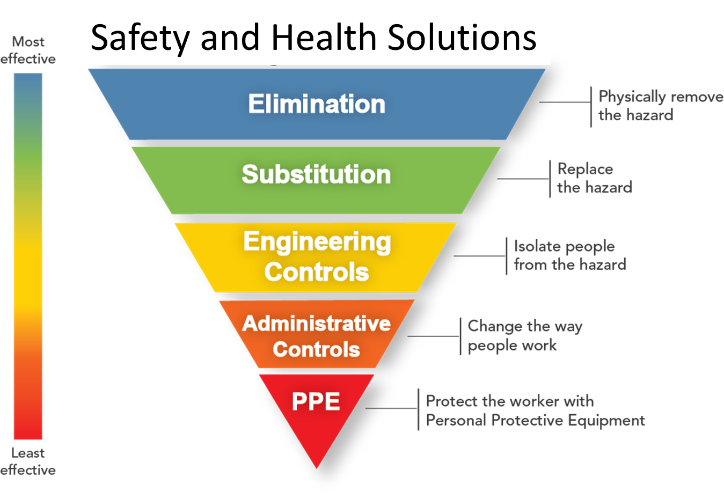
Look for these solutions first.
It’s better to change the workplace…
…than it is to change how people work.
Notes:
This is often called the hierarchy of controls. When looking for solutions for a hazard, start at the top with the more effective methods. If you can get rid of a hazard entirely, the job will be much safer, and you won’t have to monitor employees to make sure they’re avoiding the hazard. It sometimes seems easiest to train employees on safe work methods and hope for the best, but over time people forget their training and bad habits develop. Changing the workplace so that it’s safer is a much better, more permanent solution. Very often, solutions in more than one of the categories above will be needed. For example, you can make engineering changes such as using a better tool for the job, but you’ll also want to train employees on how and why to use the tool. They might also still need Personal Protective Equipment (PPE) for the job. The image is modified from a NIOSH illustration.

Slide 11
Reduce one or more risks to reduce overall risk
 | Force | Posture | Repetition
Intensity | Reduce the amount of force required | Keep wrists as straight as possible | Reduce the speed of movements
Frequency | Reduce how often force is applied | Reduce wrist bending motions | Reduce the number of movements per minute
Duration | Reduce the total duration of forceful exertions | Reduce the total duration of tasks that require wrist bending | Reduce the total duration of repetitive tasks
Combinations | Reduce force first, then wrist bending, then repetitive motions
Notes:
The risk table can also be a solutions table.

Slide 12
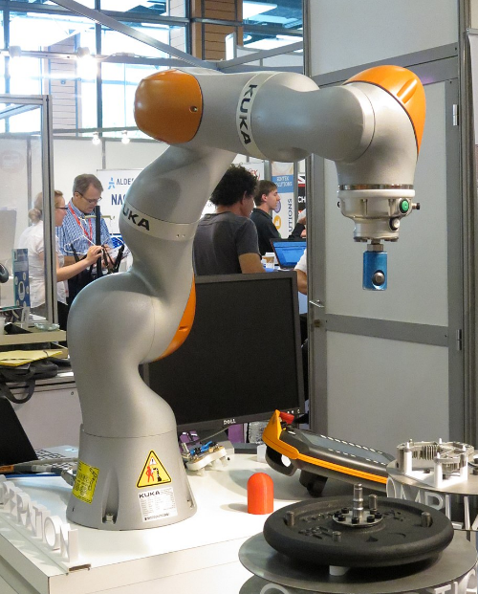
Use machines to remove risk
Automate dull, dirty or dangerous tasks
  Use collaborative robots (cobots) for repetitive tasks
Scailyna / CC BY-SA (https://creativecommons.org/licenses/by-sa/4.0)
Notes:
Mechanization means using machines to take over some tasks from workers. This isn’t the same as full automation, where you’re replacing people with machines. Cobots are useful for taking over repetitive tasks that are boring or hazardous for people. They don’t require the big cages that larger, more powerful robots need for safety.

Slide 13
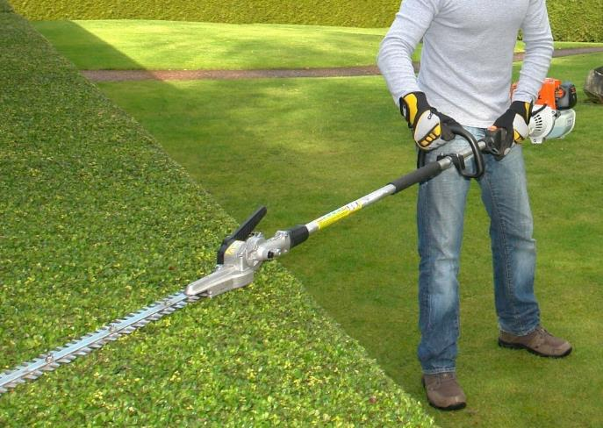
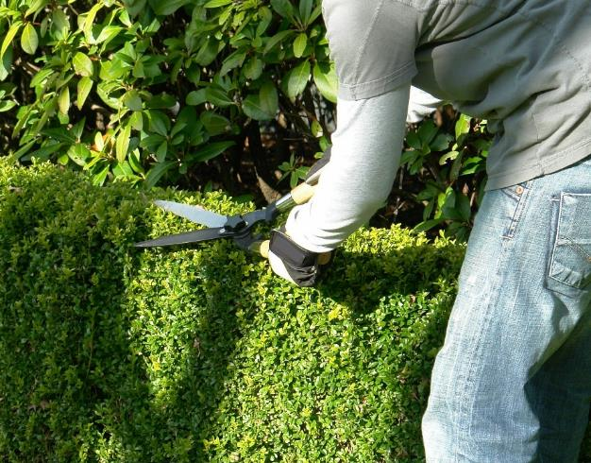
Use power tools in place of hand tools
Notes:
For bigger jobs, power tools can get the work done faster with less exposure to force and repetitive movements. The trade-off is that power tools can be heavier and can expose workers to vibration. The right power tools in the right situation can make the job safer.
Photo credit: Adobe Stock. The photos on this slide are not in the public domain.

Slide 14
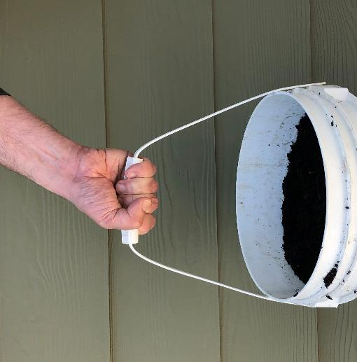
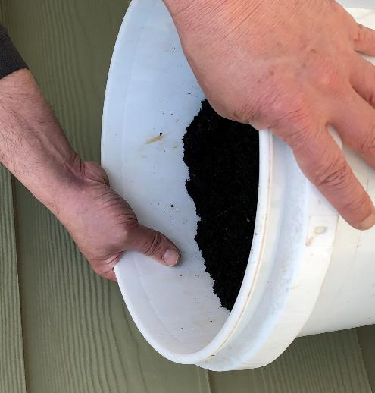
Grip, don’t pinch
A power grip…
…is 5 times stronger than…
…a pinch grip
Notes:
Gripping something with the whole hand is much stronger, and therefore less strain on the hands and wrists, than holding it with the tips of the fingers and thumbs.

Slide 15
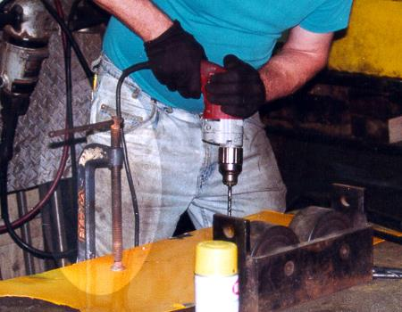
Use clamps to hold parts
Both hands are now free to hold the tool
Notes:
Using your hand as a clamp is one of the most stressful things you can do. The constant force to hold something can quickly fatigue the muscles in the hands and forearms. Using a clamp or vise to hold something will free up both hands to do the work.

Slide 16
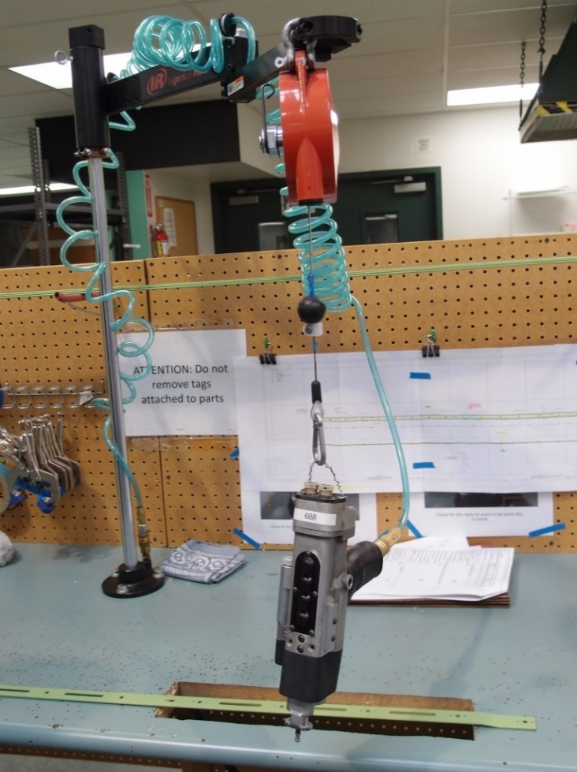
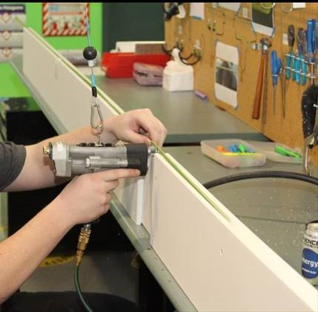
Use a counter-balance support for larger, heavier tools
Notes:
A balancer can hold the weight of the tool while still allowing it to be moved easily.

Slide 17
Choose tools that fit the hand well
Handle diameter 1-1/4 to 2 inches
Handle padded or textured for grip
Grip span
2 to 3-1/2 inches
Tools for low force,
precision tasks can be smaller
Notes:
Tools that fit the hand well will require less grip force to use.
Photo credit: NIOSH publication - Easy Ergonomics: A Guide to Selecting Non-Powered Hand Tools - https://www.cdc.gov/niosh/docs/2004-164/default.html

Slide 18
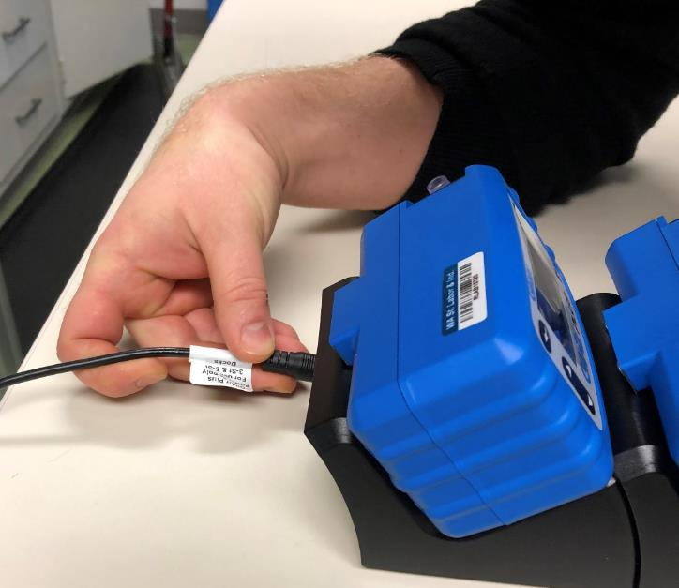
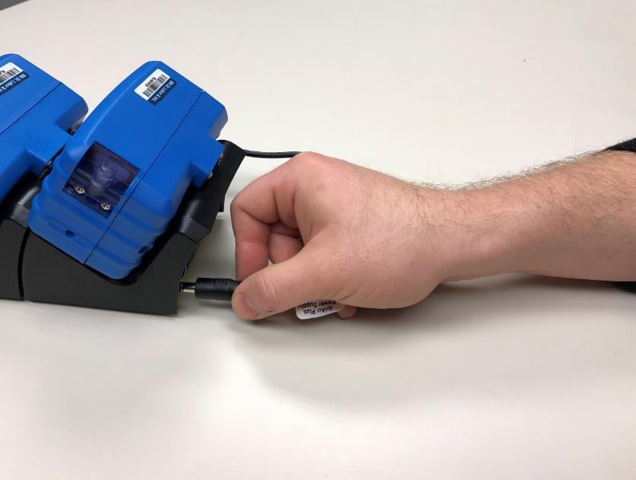
Position work to keep wrists straight
Notes:
Sometimes it’s as simple as rotating a part or piece of equipment to give better access. In assembly work, it may mean changing the order in which parts are put together in order to provide better access. Sometimes it even means redesigning a part so that it’s easier to assemble without working in awkward positions.

Slide 19
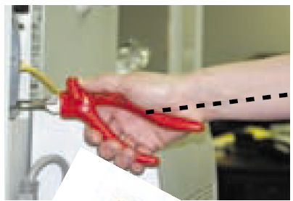
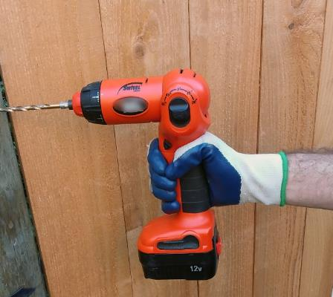
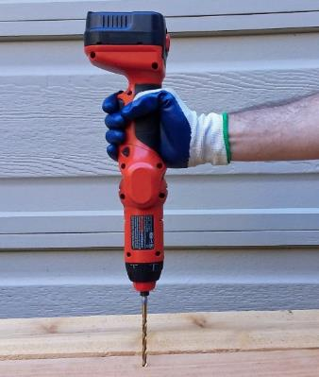
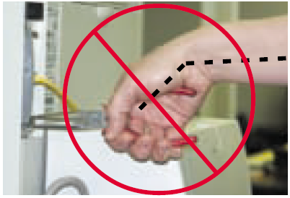
Choose tools that keep the wrist straight
The right tool depends on the height and orientation of the work.
Bend the tool…
…not the wrist.
Notes:
Deciding on the right tool for a job means looking at the task, how the work is positioned, and the space around it.

Slide 20
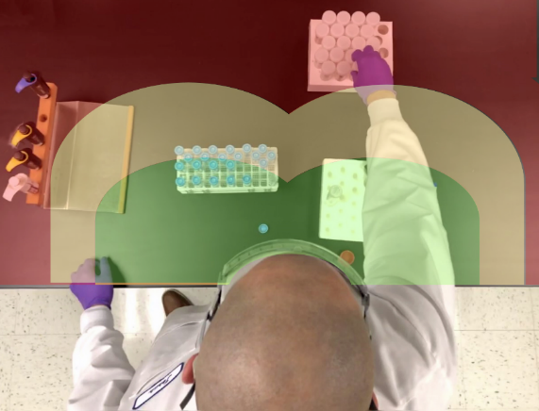
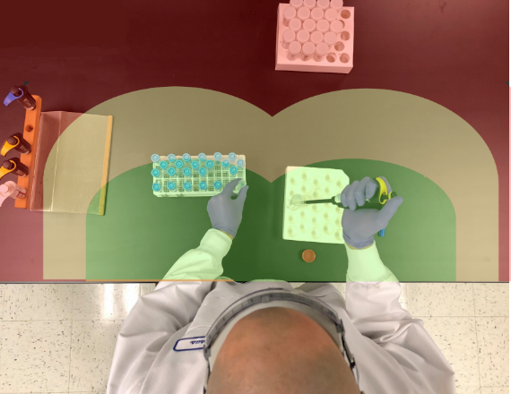
Keep it close
Long reaches can stress arms and shoulders
Keep frequently used items within easy reach
Notes:
Position work so that items that are used frequently can be reached with elbows bent and by your sides. Items that are used less often can be further away, but avoid having to lean forward and reach all of the way out.

Slide 21


Match work height to task
Place work that requires force below elbow height
Place work that requires precision above elbow height
Notes:
You can use your body weight more effectively if you place heavy work below elbow height. You’ll have an easier time seeing fine work and making precise movements if it’s above elbow height.
Photo credit: Adobe Stock. The photos on this slide are not in the public domain.

Slide 22
Avoid forearm rotation
Repeatedly rotating the forearm can lead to injuries.
Notes:
Repeatedly rotating the forearm, such as when using a screwdriver places a lot of strain on the forearm muscles. These muscles run from the hand all of the way up to the elbow, and injuries can occur to the hand, wrist or elbow. This is especially true if the wrist is bent at the same time.
Photo credit: NIOSH publication - Easy Ergonomics: A Guide to Selecting Non-Powered Hand Tools - https://www.cdc.gov/niosh/docs/2004-164/default.html

Slide 23
Reduce the amount of repetition
Reduce the number of repetitions per shift
  Get rid of unnecessary steps
  Improve workstation to reduce movements
  Expand job duties to include tasks without repeated movements
Notes:
Repetition can be a challenge to eliminate, but any steps you take to reduce the amount or duration of repetition can help to reduce the risk of injury.

Slide 24
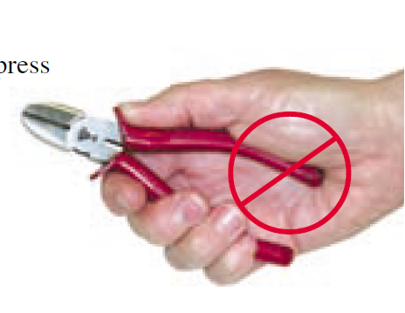
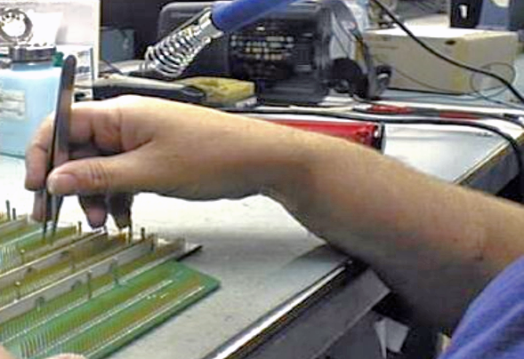
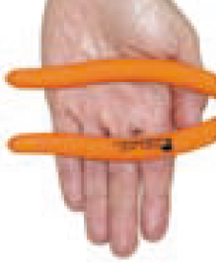
Avoid contact stress
Pressure from hard or sharp edges can damage soft tissues
Short tool handles place pressure on nerves and blood vessels
Longer tool handles spread pressure across more of the hand
Notes:
Hard or sharp edges can damage tendons, nerves and blood vessels. It’s best to position work to avoid resting on hard edges if you can. If not, you can pad the edge or provide forearm supports.
Pressure from tool handles can also cause damage to soft tissues in the hands, especially at the base of the palm. Padded handles that extend past the palm are best.
Photo credit: NIOSH publication - Easy Ergonomics: A Guide to Selecting Non-Powered Hand Tools - https://www.cdc.gov/niosh/docs/2004-164/default.html

Slide 25
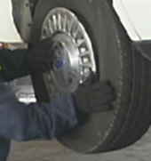
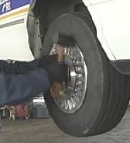
Avoid pounding or pressing with the palm
Use a tool instead
Notes:
It’s much better to use a hammer as a hammer, and not your palm.

Slide 26
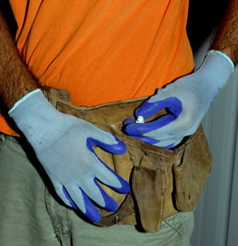
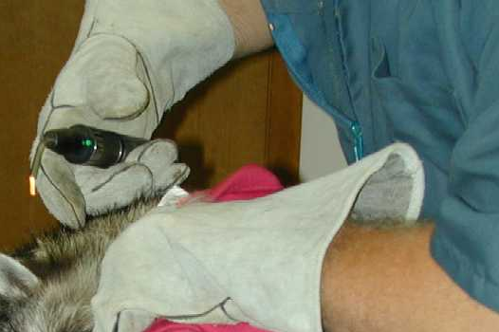
Use gloves that fit
Gloves can:
Protect the hands from contact stress
Keep hands warm
Increase friction to help with gripping
Gloves can make you grip harder, especially if they’re thick or don’t fit well.
Notes:
Gloves can be helpful for protecting the hands, but they can also increase the amount of grip force that workers use. Look for the most flexible gloves that provide the right level of protection. It’s best to buy gloves in a variety of sizes to fit workers’ hands.

Slide 27
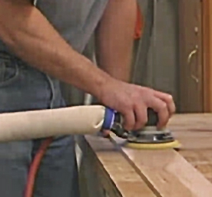
Reduce vibration exposure
Use low vibration tools*
Change processes and use machinery to reduce the time spent using handheld vibrating tools.
* Vibration level less than 2.5 m/s²
Notes:
Vibration can damage blood vessels and nerves in the hands and arms. Look for lower vibration tools, and maintain tools well to keep vibration levels at a minimum. It can also help if you can find ways to reduce the amount of “trigger time” that workers have with vibration tools. For example, grinding can be reduced by changing molds for parts so that there’s less excess material that needs to be removed. Or, parts tumblers can be used to take off rough edges.

Slide 28
Help from L&I at no cost to you
We offer free, confidential consultations to help you prevent sprains and strains in your workplace.
To learn more:
Email: Ergonomics@Lni.wa.gov
Call: (360) 902-5450
Click: Get help with ergonomics
Notes:
L&I has professional Ergonomists who can work with you to assess risks and find solutions for your hand intensive jobs. Use the contact information to get in touch with us.

