Slide 1
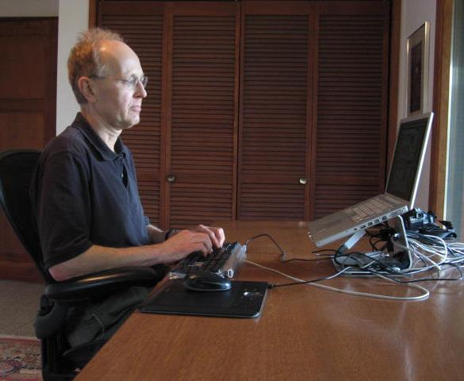
Ergonomics for remote workers
Getting comfortable in your home office

Slide 2
Objectives
Set up a home office for comfort and productivity.
Try out options to sitting at a desk in order to vary your posture.
Use healthy habits for wellness when working at home.

Slide 3
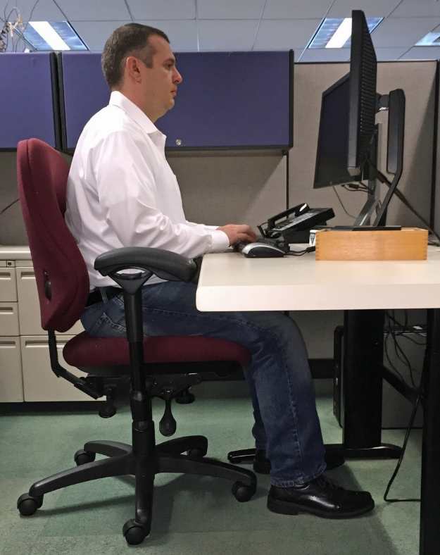
An ergonomic set up at home is the same as at work
Head level
Shoulders relaxed
Wrists straight
Low back supported
Feet supported
Notes:
You may not have all of the same equipment at home, but you should work with what you have to get into a good working posture.

Slide 4
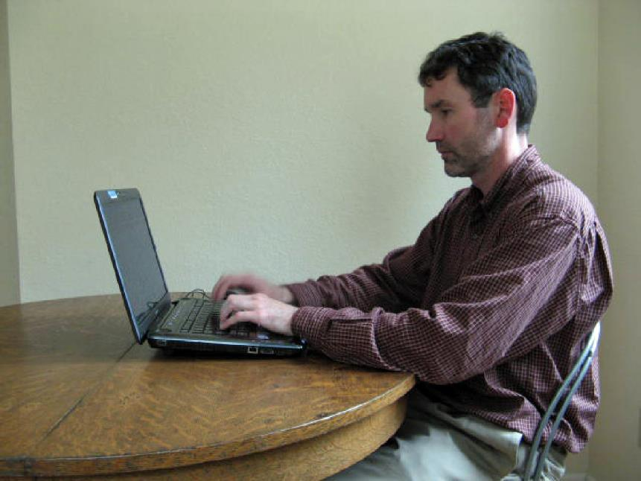
What’s wrong with a laptop at the kitchen table?
Screen too low
No back support
Keyboard too high
Hard edge
Notes:
The kitchen table might be okay for a little while, but it will get very uncomfortable if you work there too long.

Slide 5
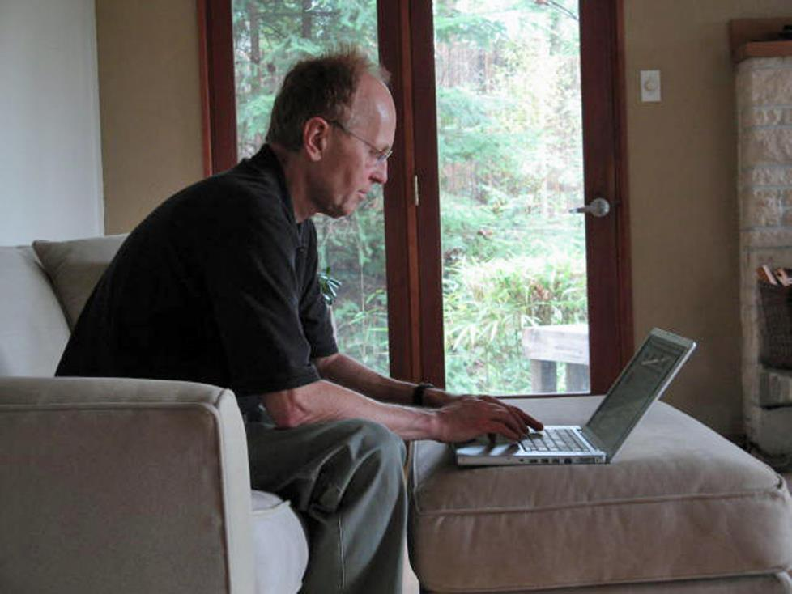
The couch may not be any better
Head tipped down
Slumped posture
Notes:
Sitting on a softer surface can help, but only if you can get your computer into a good position.

Slide 6
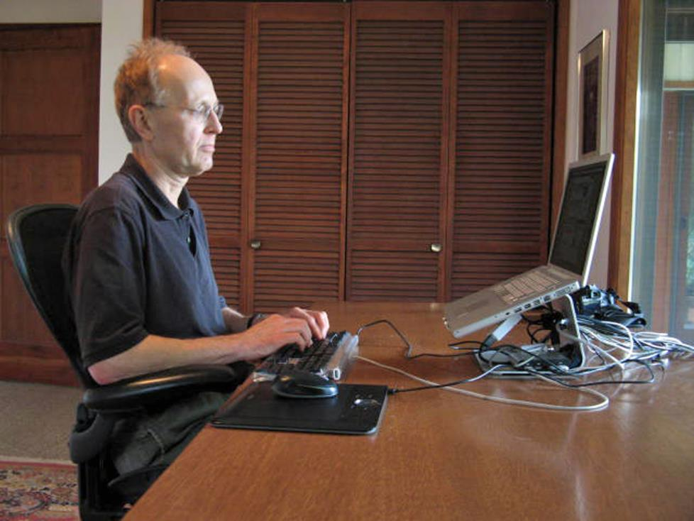
A better set up
Desk chair with low back support
Screen closer to eye level
Table close to elbow height
Full size mouse and keyboard
Notes:
Simple fixes include plugging in a keyboard and mouse, and placing the laptop on a stand to get the screen to a better height. If you don’t have a good desk chair, you can use cushions to make the seat and back of a kitchen chair more comfortable. If the only tables you have are above your elbow height, you can raise your chair, or add cushions to the seat to get higher. You may need to use a sturdy box or something similar for foot support if your feet no longer touch the floor.

Slide 7

A full-size monitor can reduce eye strain
Notes:
A larger screen will make it easier to see words and images. You might be able to plug in a larger external screen to your laptop. The top of the monitor screen should be about eye level. If it’s too low, you can place the monitor on some books to get the screen to the right height. You can use the laptop keyboard and touchpad, but you might find it more comfortable to use a separate keyboard and mouse. If you want to use your laptop as a second screen, you should raise it up to the same level as the monitor to avoid bending your neck.

Slide 8
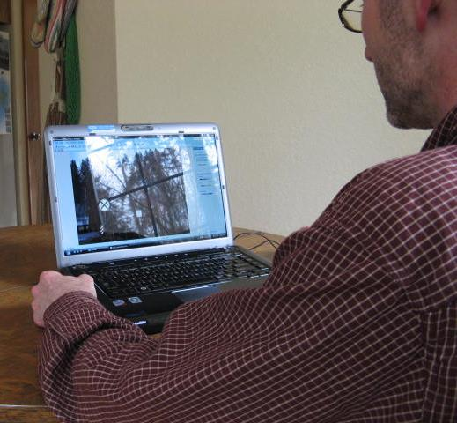
Avoid glare by positioning your screen away from windows
Notes:
You can get eye strain if you sit facing a bright window or with a bright light directly behind you. Sit sideways to bright light sources. If glare is a problem, close the blinds or curtains.

Slide 9
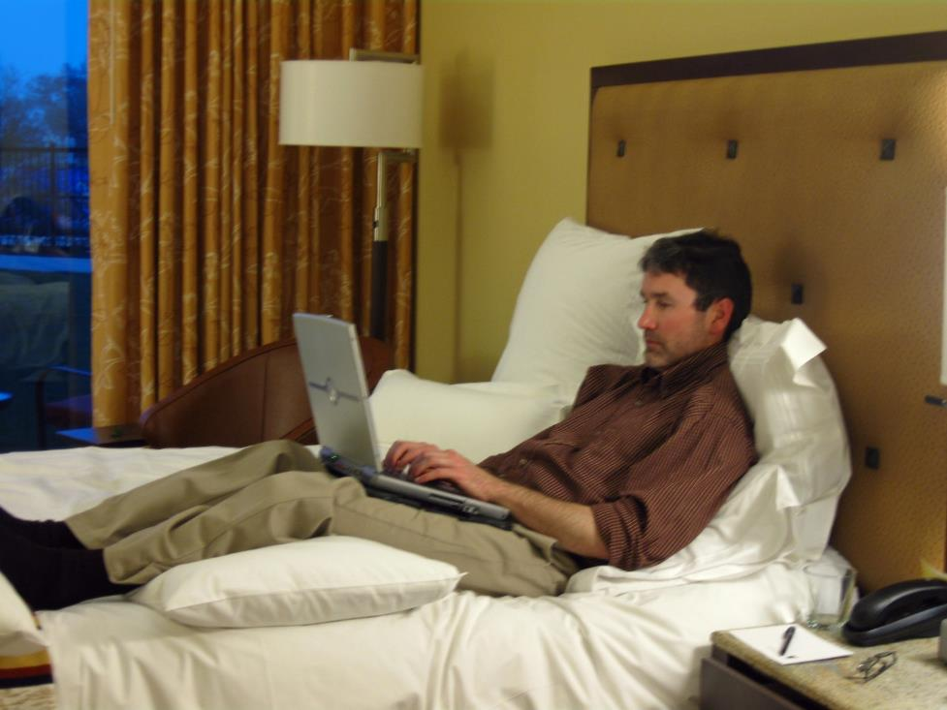
A relaxed position can still be very productive
Keep your wrists straight
Pillow under knees raises lap to bring screen higher
Extra pillows for back and neck support
Notes:
Stretching out on a bed or couch can provide a break from sitting at a desk. But don’t get too comfortable! Even a relaxed position should be changed every hour or so.

Slide 10
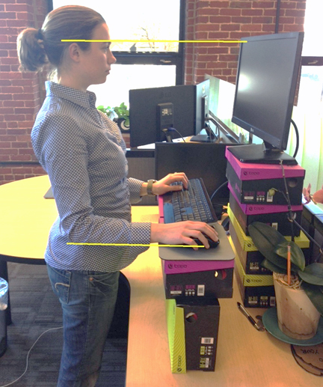
Standing some of the time may take creativity
Eyes at least 18 inches from monitor
Top of screen at eye level
Make sure it’s stable!
Keyboard and mouse at elbow level
Notes:
Standing also makes for a good break from sitting. If you don’t have a standing desk at home, you might be able to find a creative way to raise the keyboard, mouse and monitor. Just make sure to stay safe and place everything on stable surfaces.

Slide 11
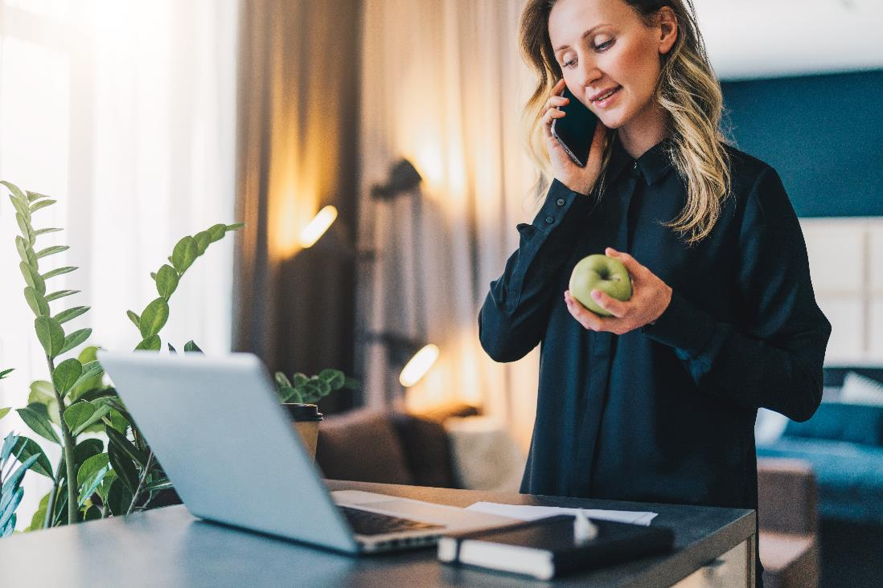
Try to stand when not using the computer
Notes:
If you can’t stand up when you’re using the computer, you might still be able to stand when talking on the phone, or working with papers.

Slide 12
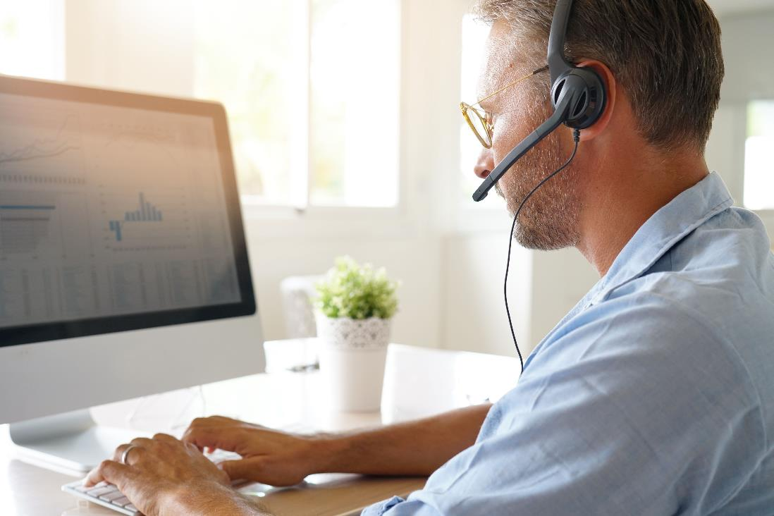
A headset can help with head and neck posture
Notes:
Rather than holding a phone up to your ear, plugging in a headset or using the earbuds can help you keep your neck and shoulders relaxed. Headsets are also very helpful for online meetings or webinars.

Slide 13

Healthy habits
Change position often
Take a short break every hour or so
Go for a walk on longer breaks
Notes:
No one position is likely to be comfortable enough to work in all day. You may have fewer interruptions when working at home, so you’ll need to remind yourself to change positions periodically. If you find that you get caught up in your work and aren’t moving enough, you can set reminders in your online calendar or on your phone. Take a short break as you change positions, and stretch or get something to drink. Get outside if you can during longer breaks, and go for a walk to get your heart pumping and to loosen up your muscles.

